Slide 1
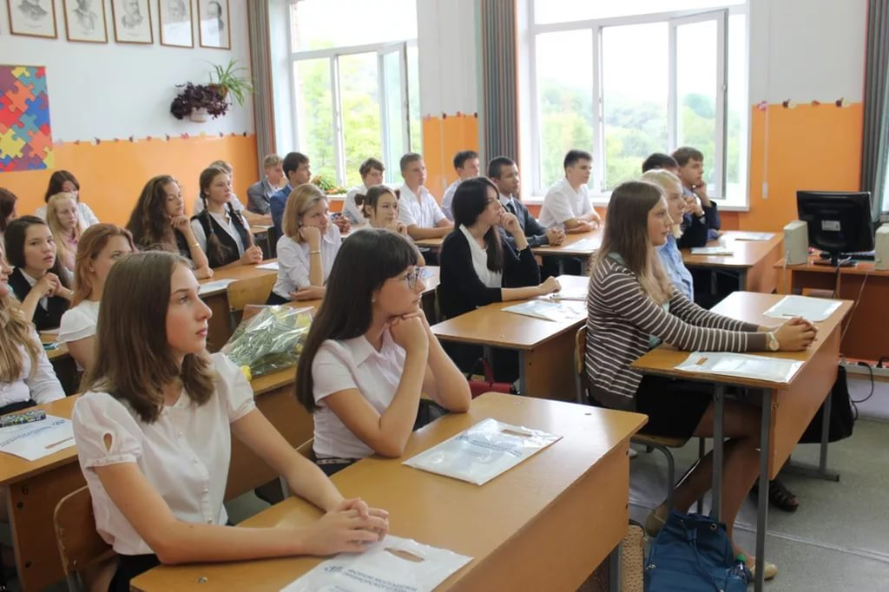
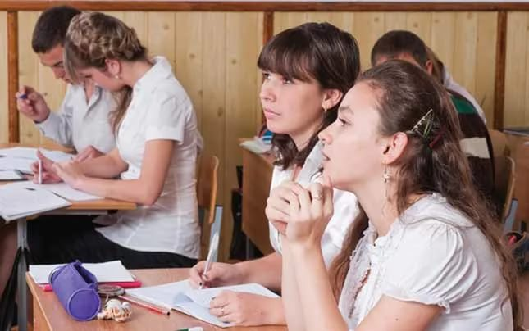

Slide 2
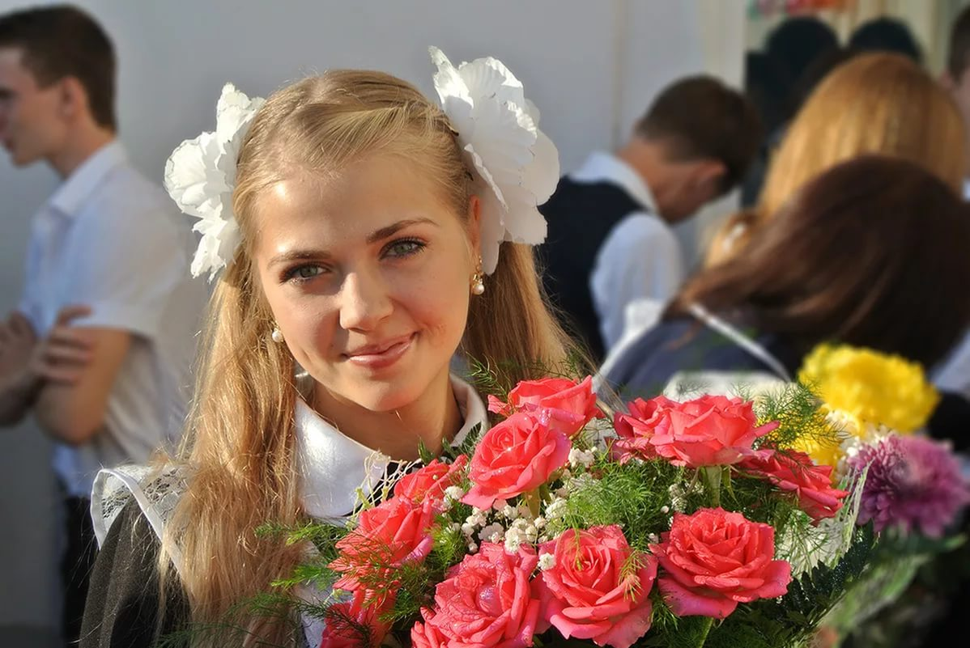
School Life

Slide 3
Put in the following words into the sentences nervous, marks, wear, elective, discipline, projects
Pupils ….a school uniform.
On the first of September pupils feel…..
It’s important to keep …at school.
Some students choose…subjects to learn.
Pupils make …at school.
ABC are … given to assess a student’s work.

Slide 4

Listen to three teenagers talking about their first day at school.

Slide 5

Present Perfect употребляется
Для описания событий, которые начались в прошлом и завершились к настоящему времени.
Для описания событий, которые произошли в прошлом, но их результат важен в настоящем.
Для описания действия, которое началось в прошлом и еще не закончилось.

Slide 6
Схема образования
I
You
We
They
He
She
It
have V3
has V3

Slide 7

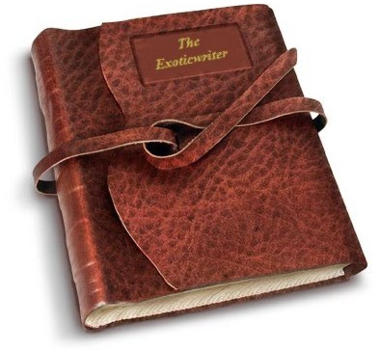
The boy has read
the book.

Slide 8
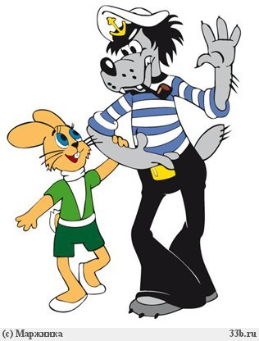
-
Указатели Present Perfect
already - уже
just – только что
ever – когда – либо?
never – никогда -
yet – еще нет – (в конце)

Slide 9
Lisa has just written a letter to her granny.
Lisa hasn’t written a letter to her friend yet.
Отрицательные предложения

Slide 10
Вопросы
We have already had dinner.
Общий:
Have we already had dinner?
Разделительный:
We have already had dinner, haven’t we?

Slide 11
Let’s practice!
1. I (draw) a picture.
2. Tom (switch on) the light.
3. The cat (drink) its milk.
4. The tree (fall) across the road.
5. John (give) his bicycle to his brother.
6. You (make) a mistake.
7. We (eat) our dinner.
8. The train just (go).
9. I just (tell) the answer.
10. George never (be) in australia.
11. John and richard just (go away).

Slide 12
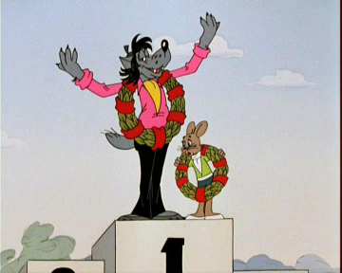
Make sentences
1. You ever / be / to South America?
2. You / read / any English books?
3. You / live / in this town all your life?
4. How many times / you / be / in love?
5. What's / the most beautiful country / you /ever / visit?
6. You ever / speak / to a famous person?

